Slide 1
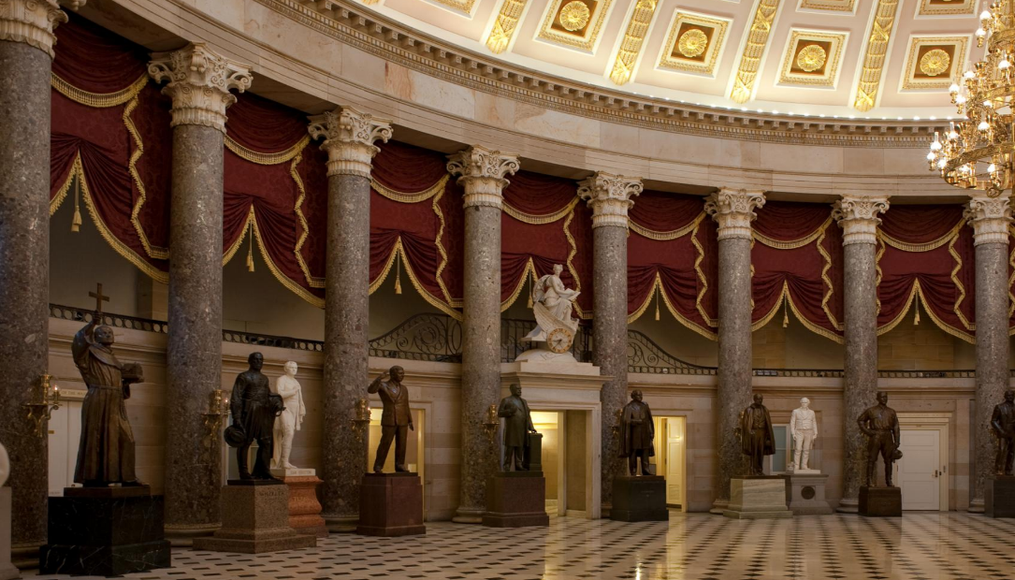
MEETING of the COMMISSION for HISTORICAL STATUES in the UNITED STATES CAPITOL 9:30 a.m. August 7, 2020
Thank you for joining us, the meeting of the Commission will begin momentarily
We are concerned about your health, and we are committed to do all we can to reduce the risk and spread of novel coronavirus. Governor Ralph Northam declared a state of emergency in Virginia on Thursday, March 12 in response to COVID-19. In light of this action, the meeting of the Commission is being conducted using electronic communications in accord with Item 4-0.01.g. of Chapter 1283 (2020 Acts of Assembly), as the COVID-19 emergency makes it impracticable or unsafe to assemble
in a single location. The purpose of the meeting is to discuss or transact the business statutorily required or necessary to continue operation of the Commission and the discharge of its lawful purposes, duties,
and responsibilities. All Commission members and staff will be participating remotely. In the event there is a disruption in the broadcast of the meeting,
please call (804) 482-6446.
Commission for Historical Statues in the United States Capitol

Slide 2
MEETING of the COMMISSION for HISTORICAL STATUES in the UNITED STATES CAPITOL 9:30 a.m. August 7, 2020
AGENDA
Call to Order Roll Call of Attendees Approval of Meeting Agenda Approval of July 24, 2020 Meeting Minutes
Public Comment (90 minutes) Overview of Written Public Comments
Status of Request to Remove Robert E. Lee Statue Disposition of Robert E. Lee Statue Following Removal
Approval of Interim Report to the General Assembly Next Steps
Adjourn
Commission for Historical Statues in the United States Capitol

Slide 3
MEETING of the COMMISSION for HISTORICAL STATUES in the UNITED STATES CAPITOL 9:30 a.m. August 7, 2020
AGENDA
Call to Order Roll Call of Attendees Approval of Meeting Agenda Approval of July 24, 2020 Meeting Minutes
Public Comment (90 minutes) Overview of Written Public Comments
Status of Request to Remove Robert E. Lee Statue Disposition of Robert E. Lee Statue Following Removal
Approval of Interim Report to the General Assembly Next Steps
Adjourn
Commission for Historical Statues in the United States Capitol

Slide 4
MEETING of the COMMISSION for HISTORICAL STATUES in the UNITED STATES CAPITOL 9:30 a.m. August 7, 2020
AGENDA
Call to Order Roll Call of Attendees Approval of Meeting Agenda Approval of July 24, 2020 Meeting Minutes
Public Comment (90 minutes) Overview of Written Public Comments
Status of Request to Remove Robert E. Lee Statue Disposition of Robert E. Lee Statue Following Removal
Approval of Interim Report to the General Assembly Next Steps
Adjourn
Commission for Historical Statues in the United States Capitol

Slide 5
MEETING of the COMMISSION for HISTORICAL STATUES in the UNITED STATES CAPITOL 9:30 a.m. August 7, 2020
AGENDA
Call to Order Roll Call of Attendees Approval of Meeting Agenda Approval of July 24, 2020 Meeting Minutes
Public Comment (90 minutes) Overview of Written Public Comments
Status of Request to Remove Robert E. Lee Statue Disposition of Robert E. Lee Statue Following Removal
Approval of Interim Report to the General Assembly Next Steps
Adjourn
Commission for Historical Statues in the United States Capitol

Slide 6
MEETING of the COMMISSION for HISTORICAL STATUES in the UNITED STATES CAPITOL 9:30 a.m. August 7, 2020
AGENDA
Call to Order Roll Call of Attendees Approval of Meeting Agenda Approval of July 24, 2020 Meeting Minutes
Public Comment (90 minutes) Overview of Written Public Comments
Status of Request to Remove Robert E. Lee Statue Disposition of Robert E. Lee Statue Following Removal
Approval of Interim Report to the General Assembly Next Steps
Adjourn
Commission for Historical Statues in the United States Capitol

Slide 7
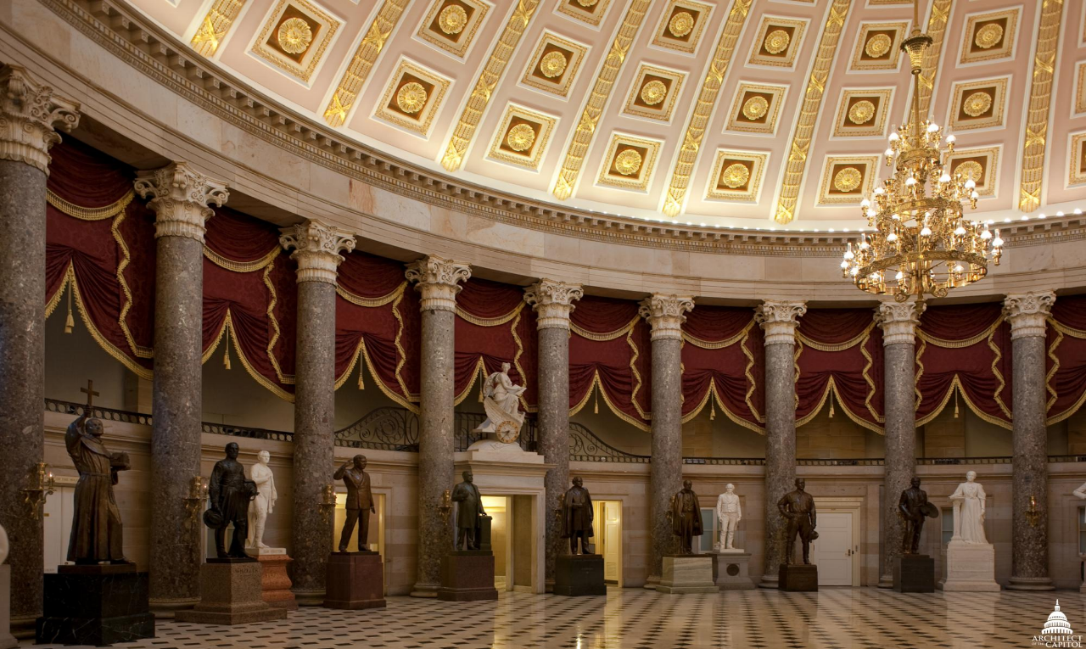
Public Comment
Commission for Historical Statues in the United States Capitol

Slide 8
MEETING of the COMMISSION for HISTORICAL STATUES in the UNITED STATES CAPITOL 9:30 a.m. August 7, 2020
AGENDA
Call to Order Roll Call of Attendees Approval of Meeting Agenda Approval of July 24, 2020 Meeting Minutes
Public Comment (90 minutes) Overview of Written Public Comments
Status of Request to Remove Robert E. Lee Statue Disposition of Robert E. Lee Statue Following Removal
Approval of Interim Report to the General Assembly Next Steps
Adjourn
Commission for Historical Statues in the United States Capitol

Slide 9
Overview of Written Public Comment Julie Langan
Commission for Historical Statues in the United States Capitol

Slide 10
Total of written comments received via email
since last meeting: 3
Recommendation that James Madison be new subject
Recommendation that no new statue be installed
Grievance about not being called on to speak at last meeting; attached petition “to recall Governor Northam if he removes Robert E. Monument.”
Commission for Historical Statues in the United States Capitol

Slide 11
MEETING of the COMMISSION for HISTORICAL STATUES in the UNITED STATES CAPITOL 9:30 a.m. August 7, 2020
AGENDA
Call to Order Roll Call of Attendees Approval of Meeting Agenda Approval of July 24, 2020 Meeting Minutes
Public Comment (90 minutes) Overview of Written Public Comments
Status of Request to Remove Robert E. Lee Statue Disposition of Robert E. Lee Statue Following Removal
Approval of Interim Report to the General Assembly Next Steps
Adjourn
Commission for Historical Statues in the United States Capitol

Slide 12
Status of Request to Remove Robert E. Lee Statue Julie Langan
Commission for Historical Statues in the United States Capitol

Slide 13
MEETING of the COMMISSION for HISTORICAL STATUES in the UNITED STATES CAPITOL 9:30 a.m. August 7, 2020
AGENDA
Call to Order Roll Call of Attendees Approval of Meeting Agenda Approval of July 24, 2020 Meeting Minutes
Public Comment (90 minutes) Overview of Written Public Comments
Status of Request to Remove Robert E. Lee Statue Disposition of Robert E. Lee Statue Following Removal
Approval of Interim Report to the General Assembly Next Steps
Adjourn
Commission for Historical Statues in the United States Capitol

Slide 14
Board Discussion Regarding Disposition of the Robert E. Lee Statue Following Removal
Commission for Historical Statues in the United States Capitol

Slide 15
MEETING of the COMMISSION for HISTORICAL STATUES in the UNITED STATES CAPITOL 9:30 a.m. August 7, 2020
AGENDA
Call to Order Roll Call of Attendees Approval of Meeting Agenda Approval of July 24, 2020 Meeting Minutes
Public Comment (90 minutes) Overview of Written Public Comments
Status of Request to Remove Robert E. Lee Statue Disposition of Robert E. Lee Statue Following Removal
Approval of Interim Report to the General Assembly Next Steps
Adjourn
Commission for Historical Statues in the United States Capitol

Slide 16
MEETING of the COMMISSION for HISTORICAL STATUES in the UNITED STATES CAPITOL 9:30 a.m. August 7, 2020
AGENDA
Call to Order Roll Call of Attendees Approval of Meeting Agenda Approval of July 24, 2020 Meeting Minutes
Public Comment (90 minutes) Overview of Written Public Comments
Status of Request to Remove Robert E. Lee Statue Disposition of Robert E. Lee Statue Following Removal
Approval of Interim Report to the General Assembly Next Steps
Adjourn
Commission for Historical Statues in the United States Capitol

Slide 17
Next Steps
Send interim report to General Assembly
Arrange for removal of existing Lee statue
Enter into agreement with new custodian of statue
Develop budget for replacement and associated process
Seek public input regarding subject of new statue
Commission for Historical Statues in the United States Capitol

Slide 18
MEETING of the COMMISSION for HISTORICAL STATUES in the UNITED STATES CAPITOL 9:30 a.m. August 7, 2020
AGENDA
Call to Order Roll Call of Attendees Approval of Meeting Agenda Approval of July 24, 2020 Meeting Minutes
Public Comment (90 minutes) Overview of Written Public Comments
Status of Request to Remove Robert E. Lee Statue Disposition of Robert E. Lee Statue Following Removal
Approval of Interim Report To the General Assembly Next Steps
Adjourn
Commission for Historical Statues in the United States Capitol

